Slide 1
LIGHT

Slide 2
L I G H T
An
Introduction
To
Nature
Of
The
Light
by Dr Kousik Mukherjee, Physics Dept, B B College, Asansol.

Slide 3
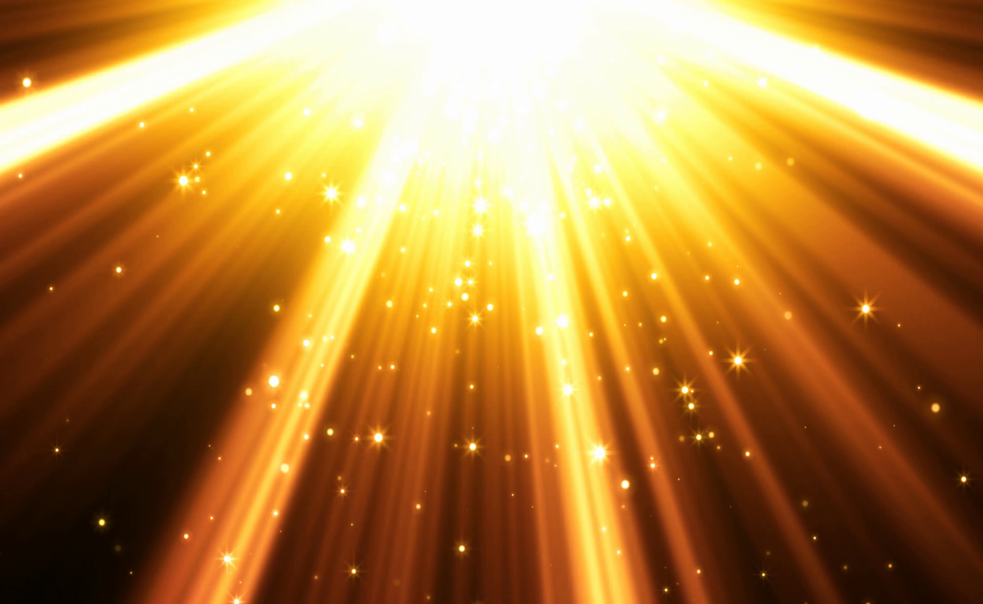
What is light?

Slide 4
Ray ? Corpuscle / Particle? Wave or Anything else?
What is Light

Slide 5
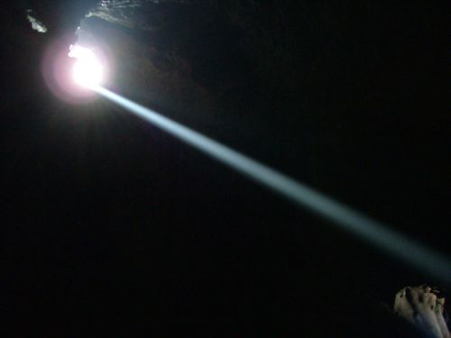
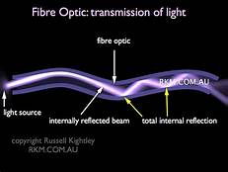
Light is Ray

Slide 6
What is a Ray?
In corpuscular theory ,
(1) the path of a corpuscle and
(2) the path of a photon .
In Wave theory , both scalar and electromagnetic
wavefront normals ,
(2) the Poynting vector ,
(3) a discontinuity in the electromagnetic
field
(4) a descriptor of wave behavior in short
wavelength or high frequency limit
(5) quantum mechanically

Slide 7
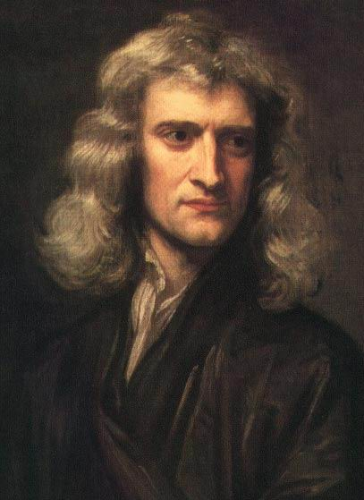
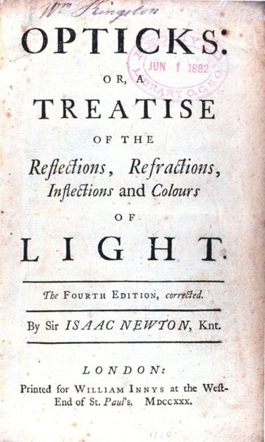
Particle theory of light
“The light and heat of the sun; these are composed of minute atoms which, when they are shoved off, lose no time in shooting right across the interspace of air in the direction imparted by the shove.”
Lucretius, ~50 BC
Sir Isaac Newton (1643-1727)
‘Is light not a body?’

Slide 8
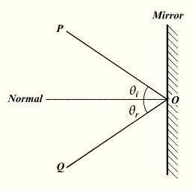
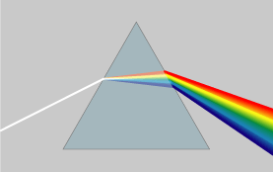
Corpuscular theory of light
Reflection
Dispersion

Slide 9
Corpuscular theory of light
Light moves in straight lines
“Light does not bend into the shadow”

Slide 10
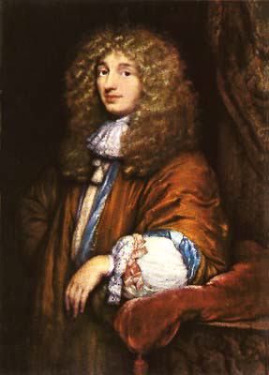
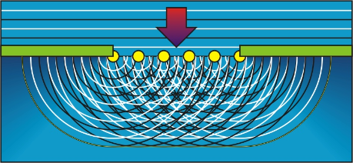
Wave theories of light
Each point on the existing wave-front can be considered to act as a source of waves (sometimes referred to as "secondary wavelets").
Christian Huygens (1629-1695)

Slide 11
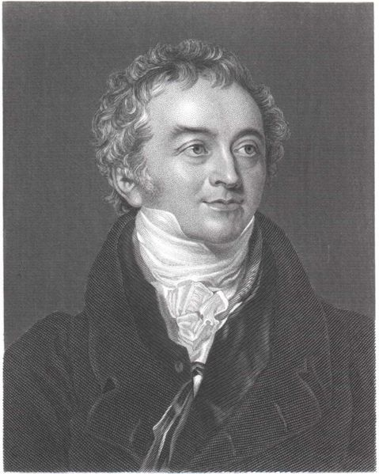
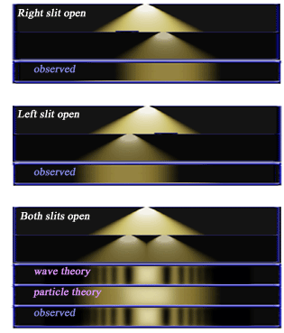
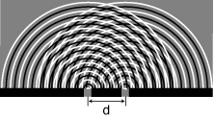
New observations: Interference
Thomas Young (1773-1829)
Light is a wave!

Slide 12
Interference in Nature
Light is a wave!

Slide 13
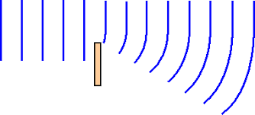
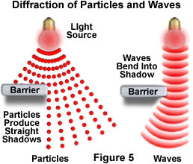
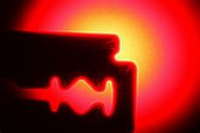
New observations: Diffraction
Light is a wave!

Slide 14
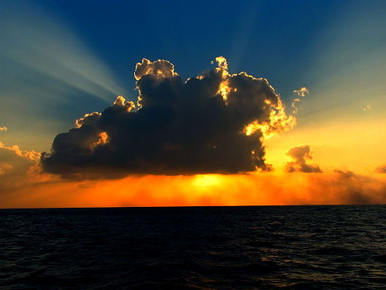
Diffraction in Nature
Light is a wave!

Slide 15
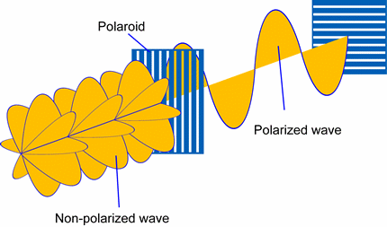
Polarization Of Light

Slide 16
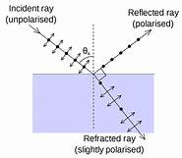
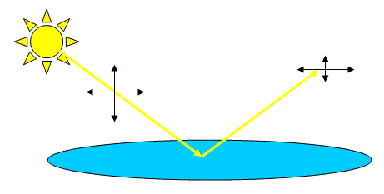
Polarization in Nature
Light is a wave!

Slide 17
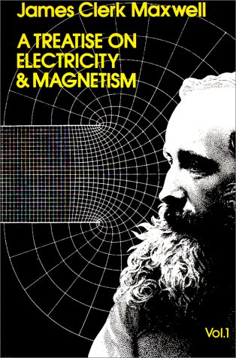
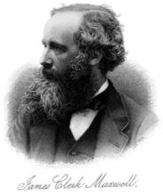
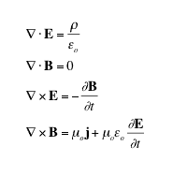
What kind of wave?
Light is an electromagnetic wave!
“This velocity is so nearly that of light, that it seems we have strong reason to conclude that light itself (including radiant heat, and other radiations if any) is an electromagnetic disturbance in the form of waves propagated through the electromagnetic field according to electromagnetic laws.”

Slide 18
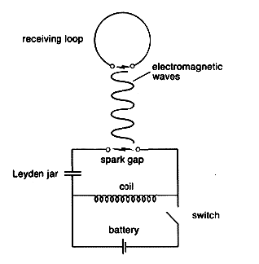
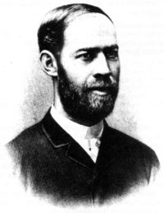
Experimental support
Heinrich Hertz (1857 - 1894)
"I do not think that the wireless waves I have discovered will have any practical application."

Slide 19
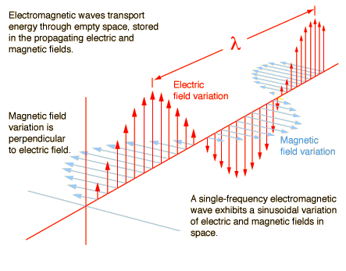
Light as waves
c
ν =
λ

Slide 20
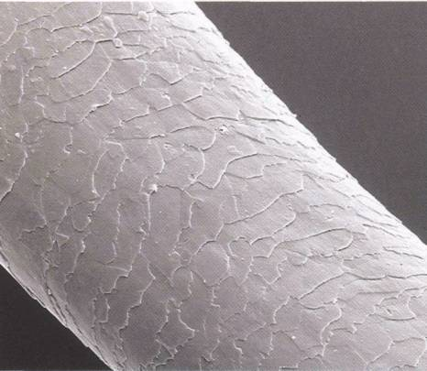
Light as waves
600 nm
= 0.6 μm
100 μm
0.6 μm
167 times as small as the diameter of a hair!

Slide 21
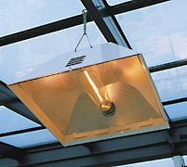
Light as waves
Sodium vapor lamps are sometimes used for public lighting. They give off a yellowish light with wavelength of 589 nm. What is the frequency of this radiation?

Slide 22
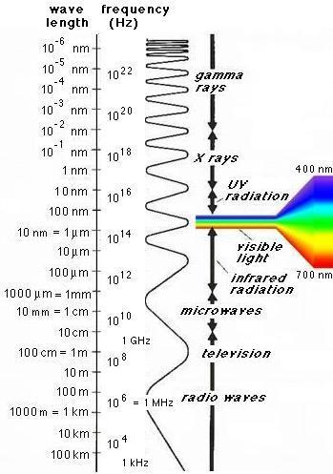
Spectrum of EM radiation

Slide 23
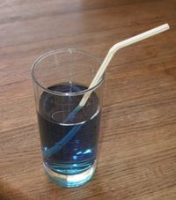
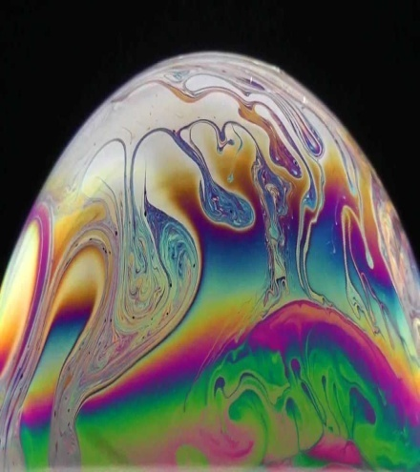
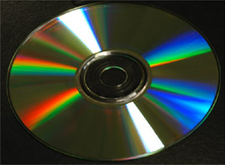
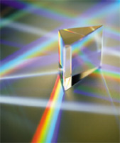
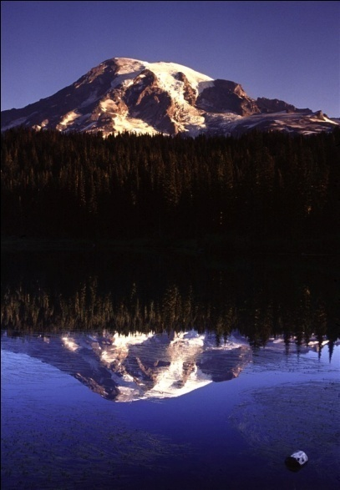
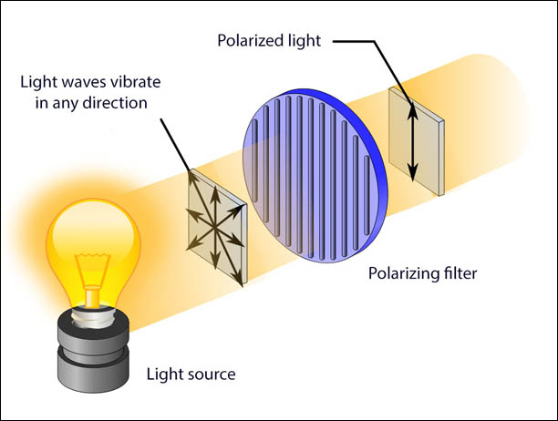
Are we done?
diffraction
refraction
Interference
dispersion
reflection
Polarization

Slide 24
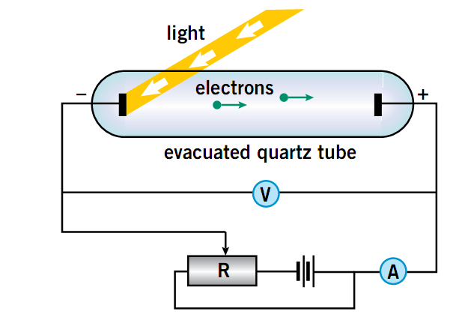
Particle nature of light(Photon)
Photoelectric effect
electrons are emitted:
- instantaneously when light is applied
- only when ν is higher than certain value.
- below that ν, intensity doesn’t matter.
One-to-one interaction of a light quantum (hν) and the electron.

Slide 25
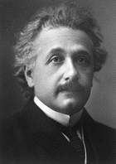
Atoms of light
“On a Heuristic Viewpoint Concerning the Production and Transformation of Light”, Einstein, 1905
Light is composed of light quanta
Light is electromagnetic radiation “associated with singular points just like the occurrence of electrostatic fields according to the electron theory”
“I therefore take the liberty of proposing for this hypothetical new atom, which is not light but plays an essential part in every process of radiation, the name photon”, Gilbert N. Lewis, 1926

Slide 26
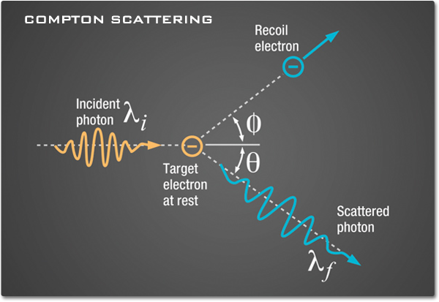
Particle nature of light(Photon)
Compton effect

Slide 27
Photons
Electromagnetic radiation has a frequency and a wavelength:
c
ν =
λ
Frequency is related to the energy of a photon:
hc
E = hν =
λ
Photons are bosons (s=1), many photons can have the same ‘state’:
E_{tot} = nhν

Slide 28
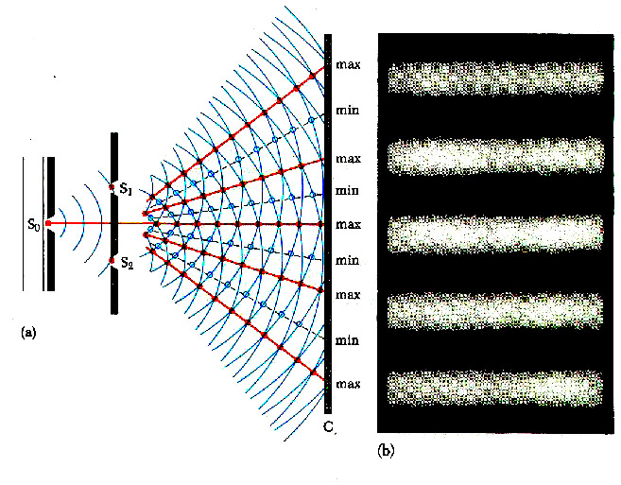
Where’s the photon?

Slide 29
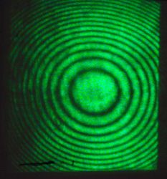
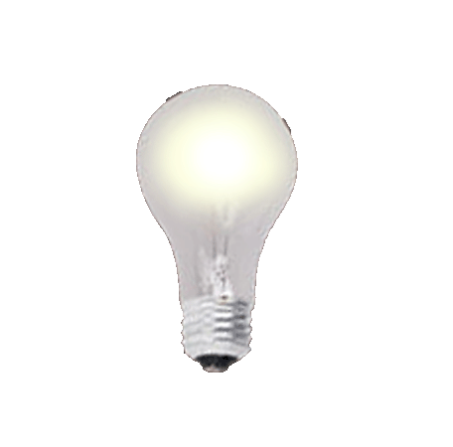
Where’s the photon?
Single photon interference

Slide 30
Strange particles
Photon ‘state’ is defined by:
- momentum
- Energy
- polarization
- spin (s=1)
Position and time (duration) of the photon are not well-defined!
“Nobody knows, and it’s best if you try not to think about it.” Richard Feynman
“These days, every Tom, Dick and Harry thinks he knows what a photon is, but he is wrong”, Albert Einstein

Slide 31
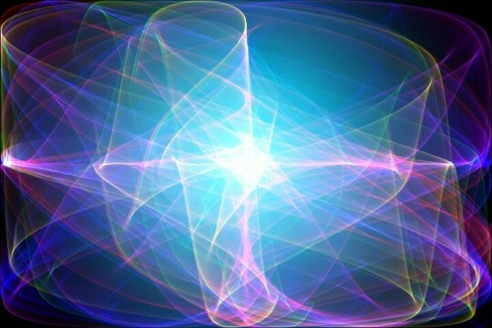
Let there be More Light…
Thank You

